Slide 1

Diabetes Prediction
By : Jing Wen

Slide 2
Table of Content
Introduction
EDA
Charts
Training the Model
Conclusion

Slide 3
Introduction
Over the recent years, there has been a rise of Singaporeans suffering from diabetes and the average age of people who are diagnosed with diabetes is getting lower.
The task is to use symptoms of diabetes to predict which symptom are likely indicator that a person has diabetes

Slide 4
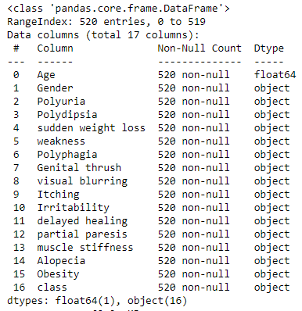

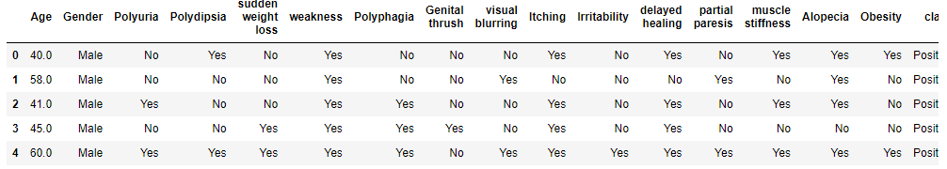
EDA

Slide 5
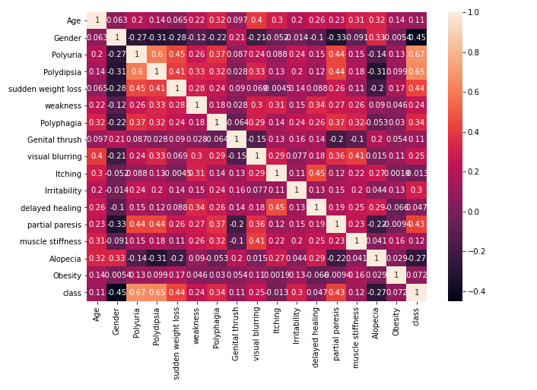
Correlation
Class is the output (Y). It says whether the person suffers from diabetes

Slide 6
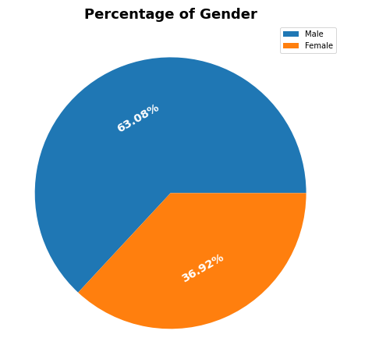
Ratio of gender

Slide 7
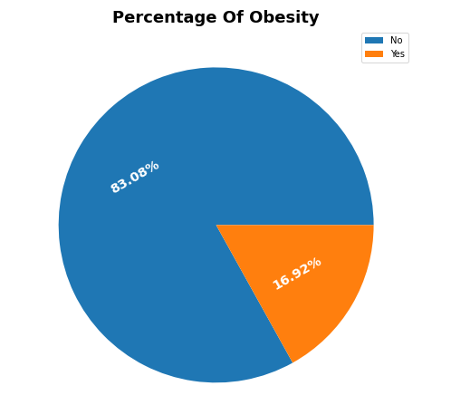
Obesity

Slide 8
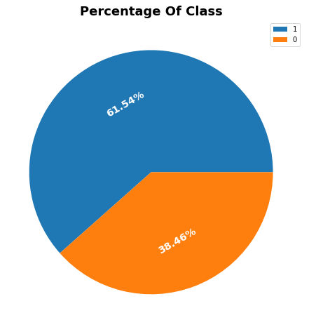
Percentage of people who suffer from diabetes
1 Represents patients who are diagnosed with diabetes

Slide 9
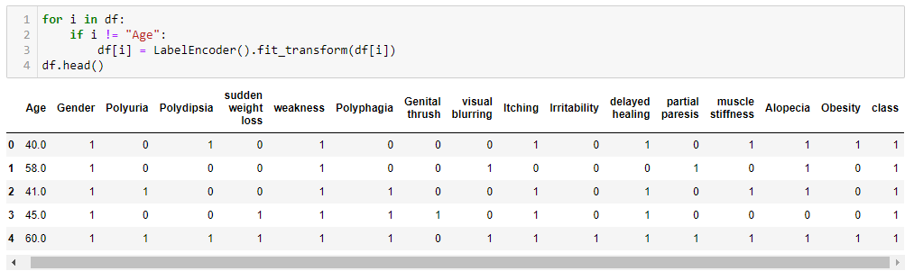
Encoding the data to make it work

Slide 10
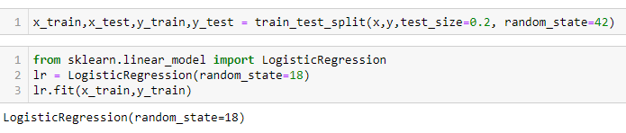
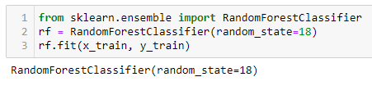

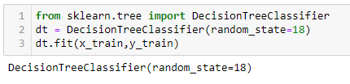
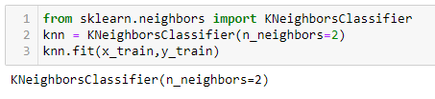
Training the models

Slide 11
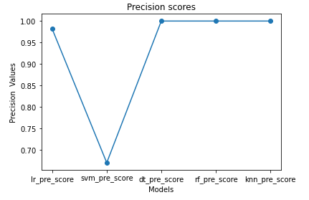
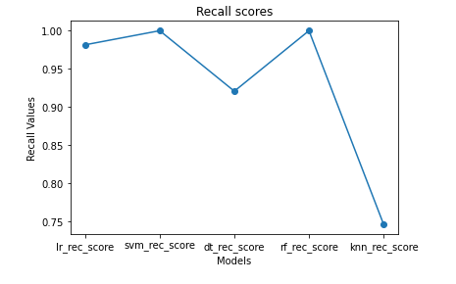
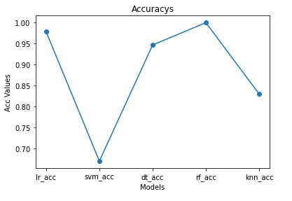
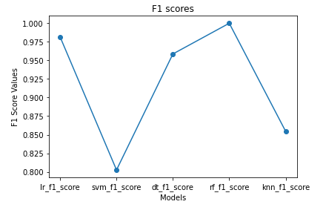

Slide 12
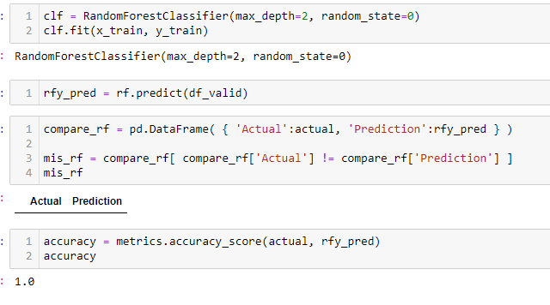
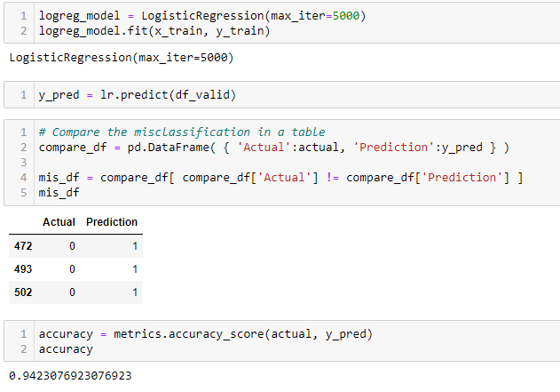

Slide 13
Conclusion
The prediction from the Logistic Regression model is able to predict 94% (49/52) whether a person has diabetes based on the symptoms
According to the model, people with polyuria and polydipsia symptoms were has high chance of diabetes
The percentage of women who has diabetes is more than men based on the data

